Slide 1
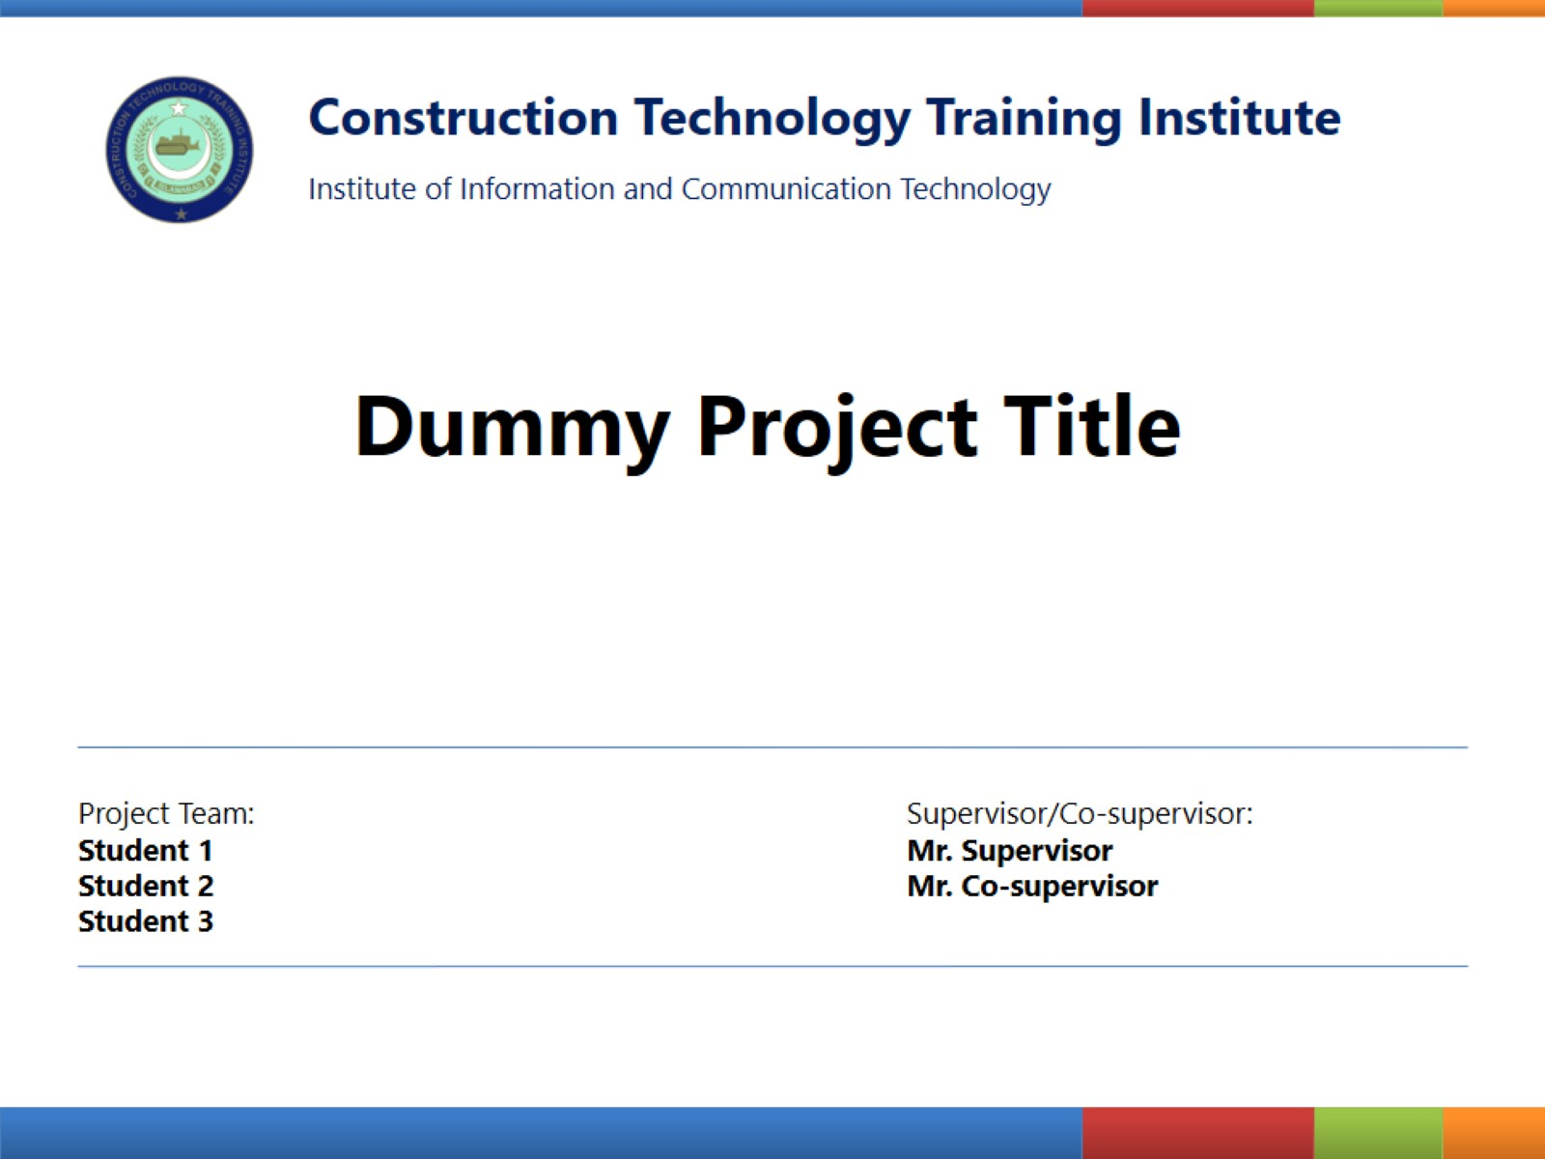
Construction Technology Training Institute
Institute of Information and Communication Technology
FINAL YEAR PROJECT
SYNTHETICA
Deepfake Image Detection System
PROJECT TEAM:
SUPERVISOR:
Uzair Ghani
Muhammad Uzair
Umer Yasir
Muhammad Bilal
Muhammad Sufyan
Mr. Hassan Ayaz
CT Department, CTTI Islamabad
SESSION: 2023 - 2026

Slide 2
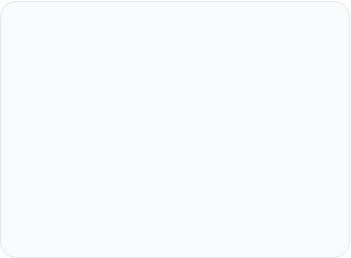




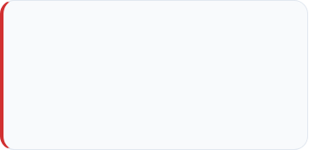
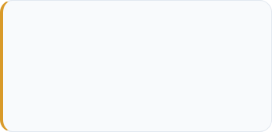
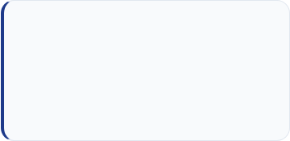
Everyone
Problem Statement
Across every professional sector, the lack of verification tools is creating a "Post-Truth" environment.
Social Media
Rapid spread of viral
misinformation.
Journalism
AI documents bypass
manual KYC checks.
Legal
Courts face fabricated
"Deepfake Evidence".
Banking
AI documents bypass
manual KYC checks.
The Alarming Statistics
900%
Annual Growth
Flooding digital channels faster than manual monitoring can handle.
>50%
Human Inaccuracy
Trained experts fail at detection, equating to a random coin flip.
60%
Synthetic Content
Analysts estimate nearly all online visual
media will be AI-generated by 2026.

Slide 3

Team members
  At the first glance fake image images might not seem problem to you but these fake images are causing problems in variety of fields.
  For example, these fake images can be used to bypass biometric security
  In Legal & Judicial fields: Lawyers and judges are being presented with "fake images as Evidence" to mislead the court.
  There is also Banking and finance: Scammers are useing AI-generated images and voice-cloning are facing that easily bypass manual human checks to trick employees or individuals into transferring money or providing confidential information..
  In Journalism: Reporters are unable to verify the authenticity of images from conflict zones The Fabricated images can go viral, leading to panic or false beliefs.

Slide 4
Team members
Problem Statement
Same in social media: Fake images are being use to blackmail people
  According to authentic Sites there are statisctics showing that :
  Deepfake content is growing at an rate of 900% each year
  Research shows that even trained experts fail to identify high-quality deepfakes more than 50% of the time so its like a random coin flip. 50% chance they get it right 50% they dont
  Furthermore Analysts estimate that by 2026, nearly 60% of all online visual content could be synthetically altered or generated.

Slide 5

Everyone
Problem Statement
Meet Ahmad, a Digital Forensic Specialist. He is the first line of defense, but he is currently fighting an impossible battle .
The Naked Eye Limitation
The Weight of Responsibility
Modern AI forgeries are flawless. Human detection through pixel inspection is no longer effective.
Verifying a fake as "Real" cements fraudulent narratives into official records. There is zero room for human error.
The Technology Void
The Trust Crisis
Experts are increasingly forced to guess. In digital forensics, guessing is a systemic failure.
Relying on standard photo viewers leaves experts completely vulnerable to sophisticated AI forgeries.

Slide 6
Team members
Problem Statement
To understand why is it difficult to differentiate between real anf fake images. Let’s say there is this person named Ahmad, who is a Digital Forensic Specialist. Meaning his job is to investigates cybercrimes by collecting, preserving, and analyzing digital evidence like human face portraits. He is the first line of defense, but he is facing some problems.
This person Ahmad, he spends hours zooming into pixels looking for flaws. But modern AI is now beyond human detection

Slide 7
Team members
Problem Statement
Currently Ahmad has no specialized tools. He relies on standard photo viewers
If Ahmad verifies a fake image as "Real," he will cause an fake image to be added into official record. Same for Real image if he verifies it as fake then it will cause his cyber team to lose an authentic evidence. There is no room for error.
It is not that Ahmad is not an expert, but he is losing confidence. because He he is currently guessing and in forensics, guessing is a systemic failure.
Some of you might be wondering why are fake images even considered a problem.

Slide 8
Everyone
Project Introduction
For professionals like Ahmad, who did not even know a solution was possible, Synthetica serves as the first line of defense.
From Guesswork to Science: It is a high-performance detective engine designed to tell the investigator exactly what they cannot see: Is this image Real or Fake.
A New Standard of Truth: Delivers a 98.46% validated accuracy rate, establishing a scientific foundation for forensic reporting.
Immediate Accessibility: Accessible by web, the portal processes uploads and generates
verdicts in under 14 seconds.
Empowering the Expert: It gives him the "Digital Microscope" he was missing, allowing him to regain control over the integrity of his work.

Slide 9
Team members
Project Introduction
To solve this problem professionals like Ahmad, who did not even know a solution was possible we present for them Synthetica
Synthetica replaces the methods Ahmad’s using to manually check the images with a high-performance web application. It is a specialized tool designed to tell the investigator exactly what they cannot see: Is this image Real or Fake?
This detection system will provide an instant classification with a validated accuracy of 98.46%, giving the investigator a scientific basis for their reports.

Slide 10
Team members
Project Introduction
This app will be deployed on Internet; it will provide professionals with a centralized portal where he can upload an image and receive an answer.
Some people will see this and consider this app Synthetica will replace Ahmad; instead, it will give him the “ability" he was missing, allowing him to regain control over the integrity of his work.

Slide 11

Everyone
Aims & Objectives
Performance: Zero latency via localized inference.
Detection: Achieve >98% accuracy.
Pipeline: Implement a Double-Tier system for result reliability
Explainability: Generate Grad-CAM visual heatmaps.
Persistence: Cloud-based forensic audit logs.

Slide 12
Team members
Aims & Objectives
Our main aim and objective before creating this site was
Performance meaning using locally installed models so user can access answer without his much time wasted
Detection Achieving accuracy more than 98%
Next is Pipeline which means Implementing multiple models and pipelines to countercheck image for the best answer

Slide 13
Team members
Aims & Objectives
Explainability meaning Utilizing heatmap technology to highlight exactly where the AI detects fake artifacts
Persistence is to Design a robust cloud system to store forensic audit logs, image results and timestamps.

Slide 14
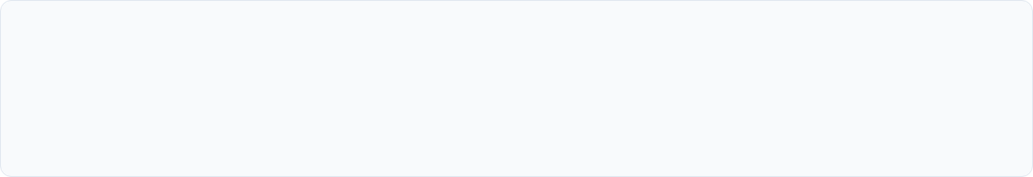

Everyone
Key Features
Beyond the "Black Box" (Explainable AI)
Moves beyond binary detection by providing visual Grad-CAM heatmaps and easy to understand graphs to explicitly prove where and how an image was manipulated.
Sovereign Balanced Ensemble (SBE)
Calculates a highly robust final verdict using a refined mathematical formula combining the models and different libraries
Cross-Platform Availability
Features a responsive web architecture ensuring full functionality across both high-end desktop workstations and Android mobile devices.

Slide 15
Team members
Key Features
Beyond the "Black Box" (Explainable AI)
First key feature and novelty of our app is visual heatmaps and easy to understand graphs to prove where and how an image was manipulated.
Sovereign Balanced Ensemble (SBE)
Second is that our app calculates a final verdict using a mathematical formula combining the different models and the libraries to countercheck the answer. We could have used the current model such as Gemini, Chatgpt and Grok as an API. But the problem was that it would have increased the latency and user will have to wait more. So, we trained our own model, yes you heard it right we have trained our own model which is specialized for the task detecting fake images. Further in the presentation my team member will explain what these models and libraries are:

Slide 16
Team members
Key Features
Cross-Platform Availability
The last is that it features a responsive web architecture ensuring full functionality across both desktop workstations for working professional and Android mobile devices for common everyday users.

Slide 17

Everyone
Dataset Aggregation
Our system was trained on an aggregated master-set of 227,000 images, moving beyond small academic samples to ensure real-world robustness:
20K
7K
200K
GAN-based high-quality faces (Deepfake-vs-Real).
Real-Edited Challenge Set for adversarial training.
Multisource Deepfake Image Dataset named as GRAVEX-200K
10K
Custom scraped Real and High-quality AI-generated visual content from
the current High-end models.
Filtering Process: Every image passed through a filter to remove duplicates and a recursive search to purge corrupted data tensors.

Slide 18
Team members
Dataset Aggregation
The quality of a good model depend on the quality of the dataset used to train the model. Our system was trained on dataset of 237 thousand images.
7K
and 200K
Dataset was imported from a website named kaggle
The 20K,
The 10K dataset was created by myself using images from good models like gemini, sora etc
Every image was passed through a filter to remove duplicates and the images that have lower quality than 10kb. Real and fake images should be balanced.

Slide 19
Everyone
Preprocessing & Selection
Model Selection: Xception Core
Powered by the Xception architecture which is an CNN.
Maps spatial (chin, eyes etc.) and cross-channel (colors) correlations separately, making it highly sensitive to unnatural pixel patterns.
Cloud Fine-Tuning Environment
Trained on high-VRAM NVIDIA T4 Tensor Core GPUs provided by Colab.
Unfrozen base layers adapted with low learning rates to catch microscopic frequency artifacts invisible to the human eye.
Face
Geometry
Texture
Eyes
Lighting
Xception (Model 1)
Xception ++ (Model 2)
It is a model trained on publicly available dataset
It is a model trained specially on high-quality self collected dataset

Slide 20
Team members
Preprocessing & Selection
Cloud Fine-Tuning Environment
Our models were Trained on high-VRAM NVIDIA T4 Tensor Core GPUs provided by Colab. Colab is an environment provided by google for the training of AI models
We trained two models for our app:
Our first model was trained on publically provided Kaggle datasets. The second model was trained on custom built dataset. The purpose of training the second model is to improve the accuracy by using the fake images from the well-known high-quality models such as nano banana, sora and grok.

Slide 21




Everyone
Smart Logic Gates
To eliminate false positives and handle poor data quality, two critical "gates" were engineered into the system:
Non-Face Filter
Quality-Aware Logic
Uses MTCNN-based detection. If the system fails to detect a high-confidence human face, it bypasses neural inference to classify the content as "Non-Photographic."
Solves the "WhatsApp Problem." It crops the human face then calculates sharpness. If quality is too low, it issues a reliability warning to the investigator.

Slide 22
Team members
Smart Logic Gates
To eliminate false results and handle poor data quality, two critical "gates" were created into the system:
The "WhatsApp Problem" means to remove low quality images that get created after the image is shared on WhatsApp. It crops the human face then checks the quality. If quality is too low, it issues a reliability warning to the investigator.
We will Use MTCNN-based detection. It is an library that detects human face in an image, If no face image is founded it label the picture as 100% fake"

Slide 23

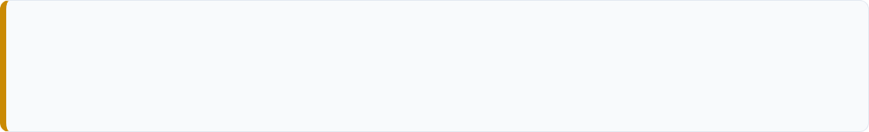
Everyone
The Forensic Pipeline
Every image undergoes a "Double-Tier" interrogation to ensure the final verdict is grounded in multiple forms of evidence:
TIER 1: METADATA & PROVENANCE
Scans internal headers for "AI Signatures" (Midjourney, DALL-E) and C2PA cryptographic manifests. If Tier 1 flags a manifest, the AI core is bypassed for an instant FAKE verdict.
TIER 2: NEURAL & SPECTRAL SCAN
Triggered if metadata is clean. The Xception Core maps structural pixel patterns while the Frequency Analysis engine detects invisible spectral artifacts in the wave domain.

Slide 24
Team members
The Forensic Pipeline
Each image pasess through “Two-Tier" interrogation to ensure the final result is as accurate as it can be:
TIER 1: METADATA & PROVENANCE
In the first tier our app checks for "AI Signatures" (Midjourney, DALL-E) and C2PA (The Coalition for Content Provenance and Authenticity) cryptographic manifests. C2PA is like an birth certificate. It contains the information about when the image was created and what technology was used. If Tier 1 find the image as fake then image is considered 100% fake

Slide 25
Team members
The Forensic Pipeline
TIER 2: NEURAL & SPECTRAL SCAN
If Tier One says the image looks clean — Tier Two activates. Tier Two is the full neural and spectral scan. The Xception model analyzes the pixel structure of the image. At the same time, our other engine runs separately and looks for invisible artifacts in the image — patterns that AI generators leave behind that human eyes cannot see.

Slide 26
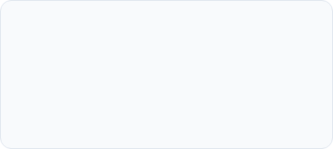

Everyone
Sovereign Balanced Ensemble
To prevent "Neural Overconfidence," we refined the weighting to a 35/35/10/10/10 distribution. This ensures physical math carries equal weight to AI intuition.
70% AI Core
10% Frequency
10% Noise
10% Edge (ELA) Logic
Primary neural pattern recognition
of facial features.
FFT-based search for
"Checkerboard" GAN artifacts.
Identifies, measures random
variations in brightness or color (grain/static)
ELA-based search for boundary and compression inconsistency.
Verdict = (Xception × 0.35) + (Xception++ × 0.35) + (Freq × 0.1) +
(Edge × 0.1) + (Noise x 0.1)

Slide 27
Everyone
.
Cloud Database Design
Synthetica utilizes Convex, a cloud-native, document-oriented database, to enable real-time synchronization of forensic reports across devices.
Persistent User History
Optimized Storage
Configured to maintain a high-speed rolling history of the last 11 scans per user. This limit ensures high performance and high-speed retrieval while providing a comprehensive audit trail for recent digital investigations.
Secure Retrieval
Cross-Platform
Forensic audit logs, graphs, heatmaps, and probability scores are tied directly to user accounts.
Allows investigators to start a scan on a
desktop and instantly review results on mobile.

Slide 28
Team members
.
Cloud Database Design
Synthetica use Convex, which is a cloud-native, document-oriented database, to enable real-time synchronization of forensic reports across all devices.
The purpose to use this instead of SQL is that Convex makes it easy to access and manage database
Persistent User History
Graphs, heatmaps, probability scores and audit logs are directly tied to user accounts and secured in cloud, allowing users to retrieve their past work every time they re-authenticate.
Cross platform abillity: Allows investigators to start a scan on a desktop and instantly review results on mobile.

Slide 29
Team members
.
Cloud Database Design
Optimized Storage: The database is configured to maintain a rolling history of the last 11 scans per user. This limit ensures high performance and high-speed retrieval of data from cloud while providing a comprehensive audit trail for recent digital investigations.

Slide 30
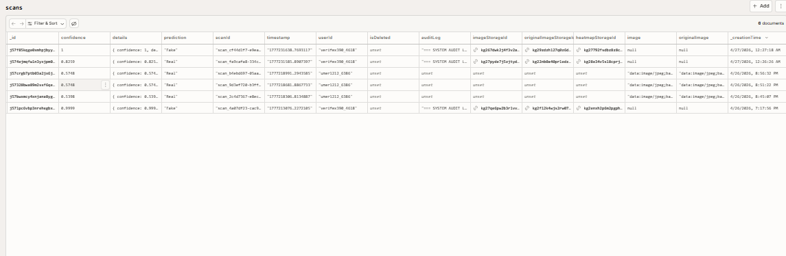
.
Cloud Database Design

Slide 31
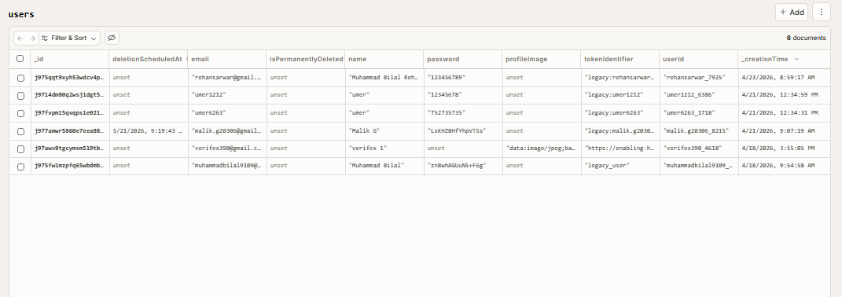
.
Cloud Database Design

Slide 32
System Architecture
USER UPLOADS IMAGE
FRONTEND (HTML/JS/React)
CONVEX CLOUD DB (Store Metadata)
PYTHON BACKEND
[ TIER 1: PROVENANCE ]
(EXIF/C2PA Checks)
(Real)
[ TIER 2 (a): AI CORE ]
(Xception + Xception ++ Model)
[ TIER 2 (b): MATH ]
(Freq /ELA(Edge)/ Noise Analysis)
(Fake)
[ SOVEREIGN BALANCED ENSEMBLE (SBE) ]
(Calculates Weighted Average: 70% AI / 10% Freq / 10% Edge / 10% Noise
[ FORENSIC REPORT GENERATION ]
(Grad-CAM Heatmaps + Probability Score)
FRONTEND DISPLAY & HISTORY SYNC
CONVEX CLOUD DB (Store results)

Slide 33
System Architecture
Live Demo (verifexapp.com)

Slide 34




Everyone
System Feasibility
Technical
Economic
Behavioral
Python ecosystem ensures
highly compatible with AI
libraries like TensorFlow and PyTorch.
Open-source models
eliminate licensing fees;
minimal one-time hosting
costs.
The inclusion of a
“Graphs and Heatmap" helps
users understand the
"why" behind a verdict.

Slide 35
Team members
System Feasibility
Technical Feasibility:
The system is built using the Python ecosystem, which is highly compatible with AI libraries like TensorFlow and PyTorch
Economic Feasibility:
By utilizing open-source models and a custom-engineered dataset, the project eliminates ongoing licensing fees making the system economically viable for long-term use. There are only one time expenditure on colab and hosting.
Behavioral Feasibility:
And The inclusion of a “Graphs and Heatmap" helps users understand the "why" behind an answer.

Slide 36
Everyone and
Team members
Results & Metrics
These are the results we got from our model after testing it on multiple pics
Edge Continuity (ELA): 97.8% Consistent
Noise Variance: 97.2% Match
98.46%
Frequency FFT: 98.1% Accuracy
Deployment: Successfully live at verifex.org
Validation Accuracy
The system bridges the gap between binary AI theory and practical forensic verification tools for digital investigators.

Slide 37
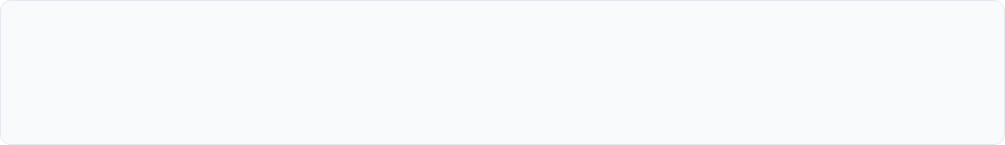
Everyone and
Team members
Future Scope
The future scope of our app is:
Future Roadmap
Expansion
Audio Forensics: Detecting fake voices.
Browser Extension will be allowing user to add the app as a chrome extension for Real-time checks.
Video Deepfakes: Detecting fake videos.
C2PA: More metadata information from emerging AI models.

Slide 38

Questions?
Thank you for your attention.
www.verifexapp.com

